Slide 1
Impact analysis of CHART project
Alberto Costa NEVES (Assistant Director)
Naohiko NAGASAKA (Project Officer of Japan)

Slide 2
In order to see the impact of CHART alumni,
what can be the progress indicator?

Slide 3
IHO Pub. C-55
Status of Hydrographic Surveying and Nautical Charting Worldwide
https://www.iho.int/iho_pubs/CB/C-55/c55.pdf

Slide 4
IHO Pub. C-55
to provide base data for governments and supporting international organizations as they consider the best means by which to implement responsibilities set out in Chapter V, Regulation 9, of the Safety of Life at Sea (SOLAS) Convention.

Slide 5
History of C-55
-> The first edition in 1991
-> The second edition in 1998
-> Database management started in 2015
(as a part of “Country Information System”, created by Dr. Kaneda, POJ)
-> IHO Online form system connected to DB in 2019 (more frequent updating)
Simple spread sheet
Postgre SQL database
Connected to Cloud service (ArcGIS Online, Formstack)

Slide 6
Visualization of C-55 information within IHO Country Information System.

Slide 7
IHO Pub. C-55
A. Hydrographic Surveying. B. Nautical Charting. C. Provision of Maritime Safety Information (MSI).

Slide 8
IHO Pub. C-55 B. Nautical Charting.
Coverage of INT (International) charts
Coverage of Raster Navigational Charts
Coverage of Electronic Navigational Charts
in three scales for each type

Slide 9
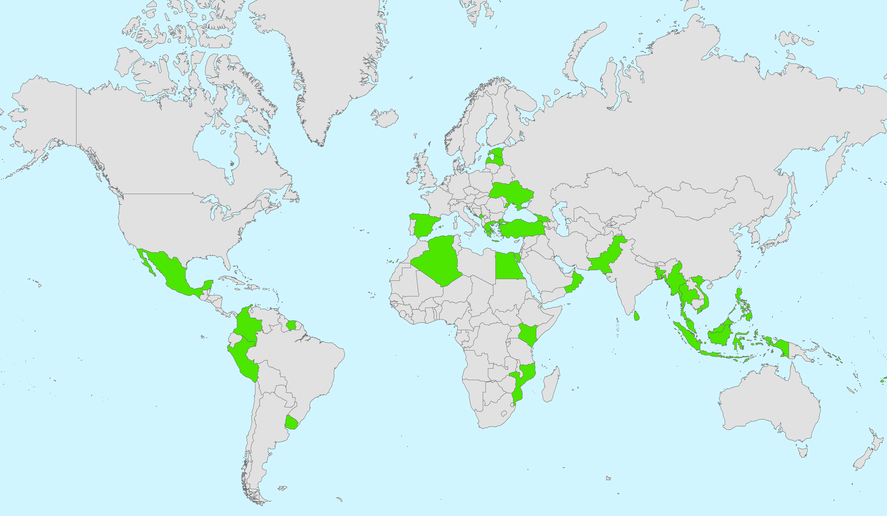
IHO Pub. C-55 data between 2014-2019 was compared.
Among 39 Alumni countries and regions (excl. extended alumni), 32 were used. (Very recent alumni countries and no-data available countries are excluded)

Slide 10
Average increase of total points of nautical charting coverage in C-55 between 2014 and 2019:

Slide 11
CHART Alumni: statistics
From 2009 to 2019, 84 alumni from 45 countries.
(incl. extended alumni)
60 % still work as cartographer
98% still work in Hydrographic Office
Specialized skill (CAT-B)
Long-term experience required
Relatively stable work condition

Slide 12
statistics

Slide 13
expected from IHO secretariat…
What have you achieved?
What will you achieve?
Cost-benefits analysis of Charting 1:91 (Vanuatu)
Hurricane Humanitarian aids and port clearance (Puerto Rico, Japan)
Ports development (El Salvador)
Liability of the State and the insurance (Norway)
MSI for the marine environment (Panama)
Tsunami Inundation charts and MSDI (Japan, Indonesia)

